Slide 1
Insurance Document AI Analyzer
Kalash Khapre, 22070521100
Deepak Yadav, 22070521023
Harsh Khapekar, 22070521112

Slide 2
Problem Statement
The Problem: Manual Document Processing
Current State:
📄 Thousands of insurance documents processed daily
⏱️ 5-10 minutes manual processing per document
❌ 15-20% error rate in data entry
💰 High operational costs
📈 Not scalable with business growth
Business Impact:
• Delayed claim processing
• Customer dissatisfaction
• Compliance risks

Slide 3
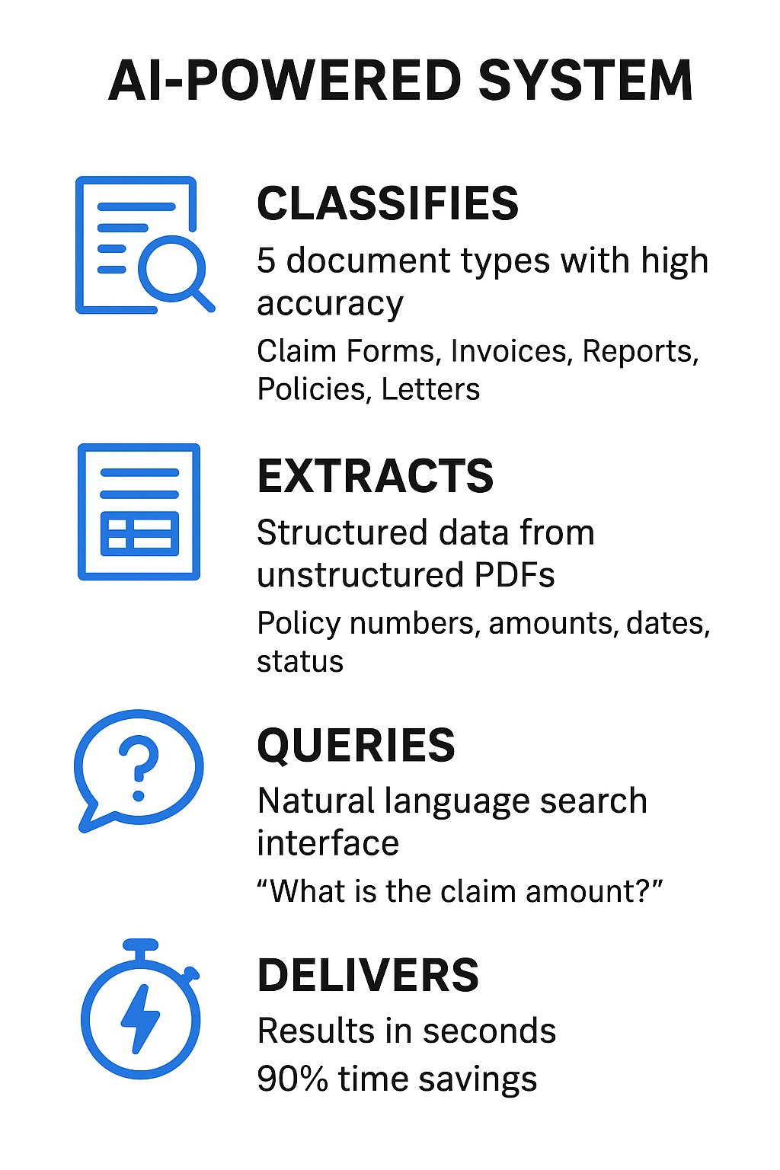
Our Solution
  An AI-powered system that automatically:
  🔍 CLASSIFIES
      → 5 document types with high accuracy
      → Claim Forms, Invoices, Reports, Policies, Letters
  📊 EXTRACTS
      → Structured data from unstructured PDFs
      → Policy numbers, amounts, dates, status
  ❓ QUERIES
      → Natural language search interface
      → "What is the claim amount?"
  ⚡ DELIVERS
      → Results in seconds
      → 90% time savings

Slide 4
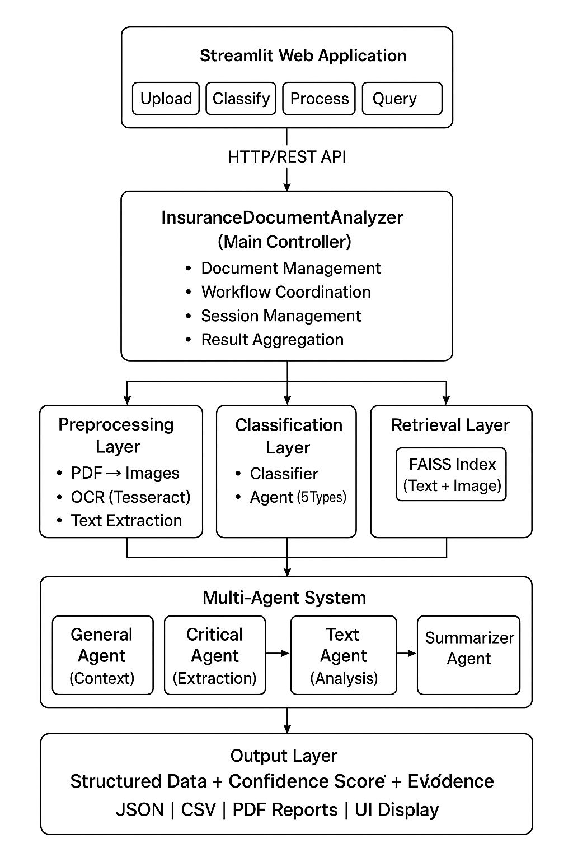
System Architecture
A user uploads a document via a Streamlit Web UI.
The Document Processing Layer uses OCR (Tesseract) to extract all text and images from the file, supporting multi-page documents.
The AI Classification Engine analyzes the extracted content using AI models (Sentence Transformers for text, CLIP for images) to determine which of 5 document types it is.
A Multi-Agent Extraction system, with specialized agents for context, critical fields, text analysis, visual analysis, and summarization, pulls out the specific information.
The system provides the final data as a Structured Output for export.

Slide 5
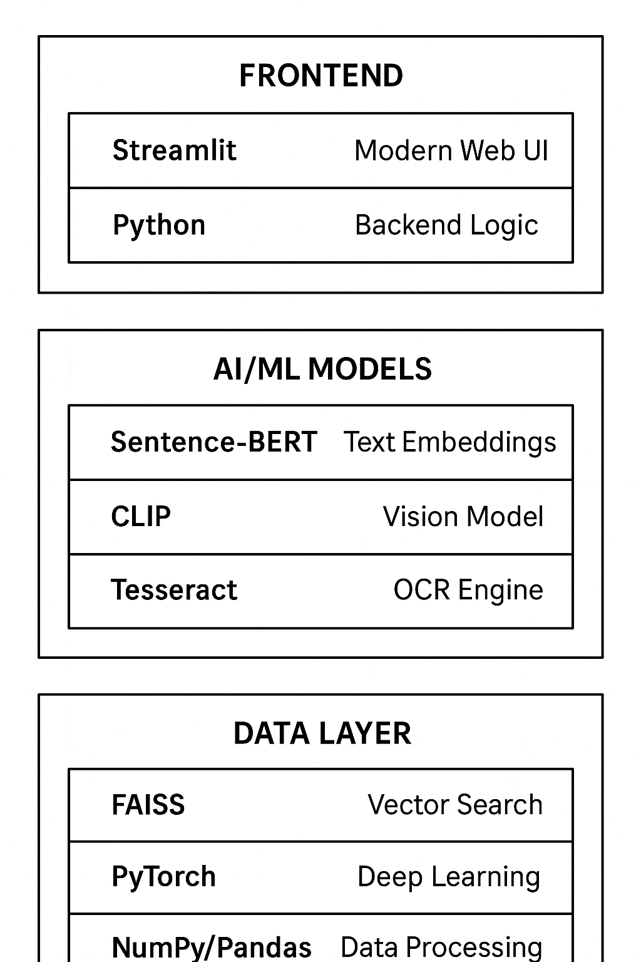
Technology Stack
Frontend: This is the user interface. It uses Streamlit to create the modern web UI and Python to handle the backend logic for the interface.
AI/ML Models: This layer contains the core AI components. Sentence-BERT is used to understand text (creating text embeddings), CLIP is a vision model for understanding images, and Tesseract is the OCR engine used to extract text from images or documents.
Data Layer: This layer manages data and computation. FAISS provides fast vector search (likely for finding similar text or images), PyTorch is the deep learning framework used to run the AI models, and NumPy/Pandas are used for data processing and manipulation.

Slide 6
Multi-Agent System
1️⃣ GENERAL AGENT
  • Combines text + image context
  • Multi-modal fusion
2️⃣ CRITICAL AGENT
  • Extracts key fields (Policy #, Amount, Date)
  • Pattern matching + NLP
3️⃣ TEXT AGENT
  • Deep textual analysis
  • Semantic understanding
4️⃣ IMAGE AGENT
  • Visual element detection
  • Table/signature recognition
5️⃣ SUMMARIZER AGENT
  • Synthesizes all findings
  • Confidence scoring
  • Structured output

Slide 7
Document Types Supported
📋 CLAIM FORMS Extract:
Claim #, Policy #, Amount, Date, Status
💰 INVOICES Extract:
Invoice #, Amount Due, Vendor, Payment Terms
🔍 INSPECTION REPORTS Extract:
Report #, Date, Property, Damage Assessment
📄 POLICY DOCUMENTS Extract:
Policy #, Coverage, Premium, Terms
📮 COVER LETTERS Extract:
Date, Recipient, Subject, Attachments

Slide 8
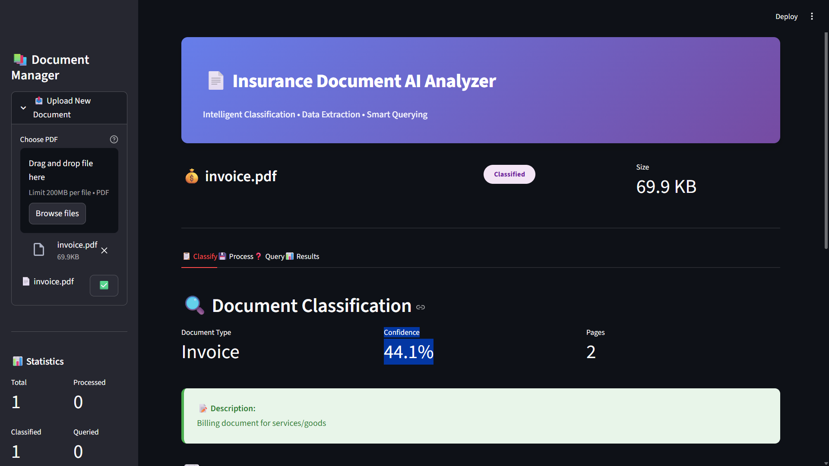
Streamlit Ui

Slide 9
Thank You

